Slide 1
Flexible space
Notes:
What if the space is not a classroom at all but viewed as a work space or Fexible space. It wouldn’t have one set of furniture setups, it would have a variety, and yet have enough furniture so one could configure it for a larger class. It would have moveable walls. Everything has wheels and where possible would be reconfigurable. Thinking about the innovative space idea:

Slide 2
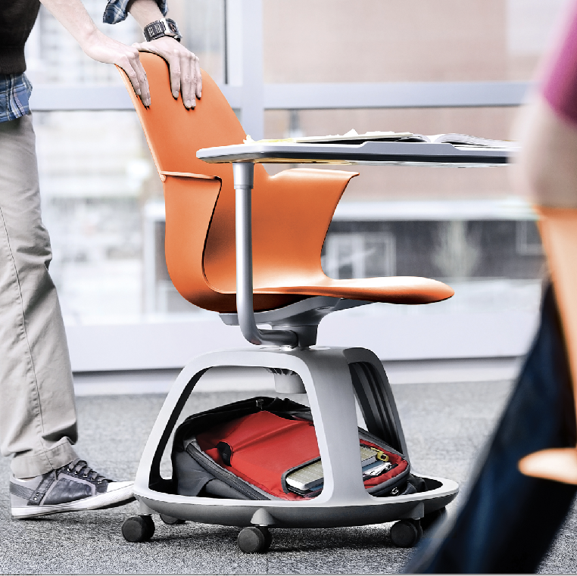
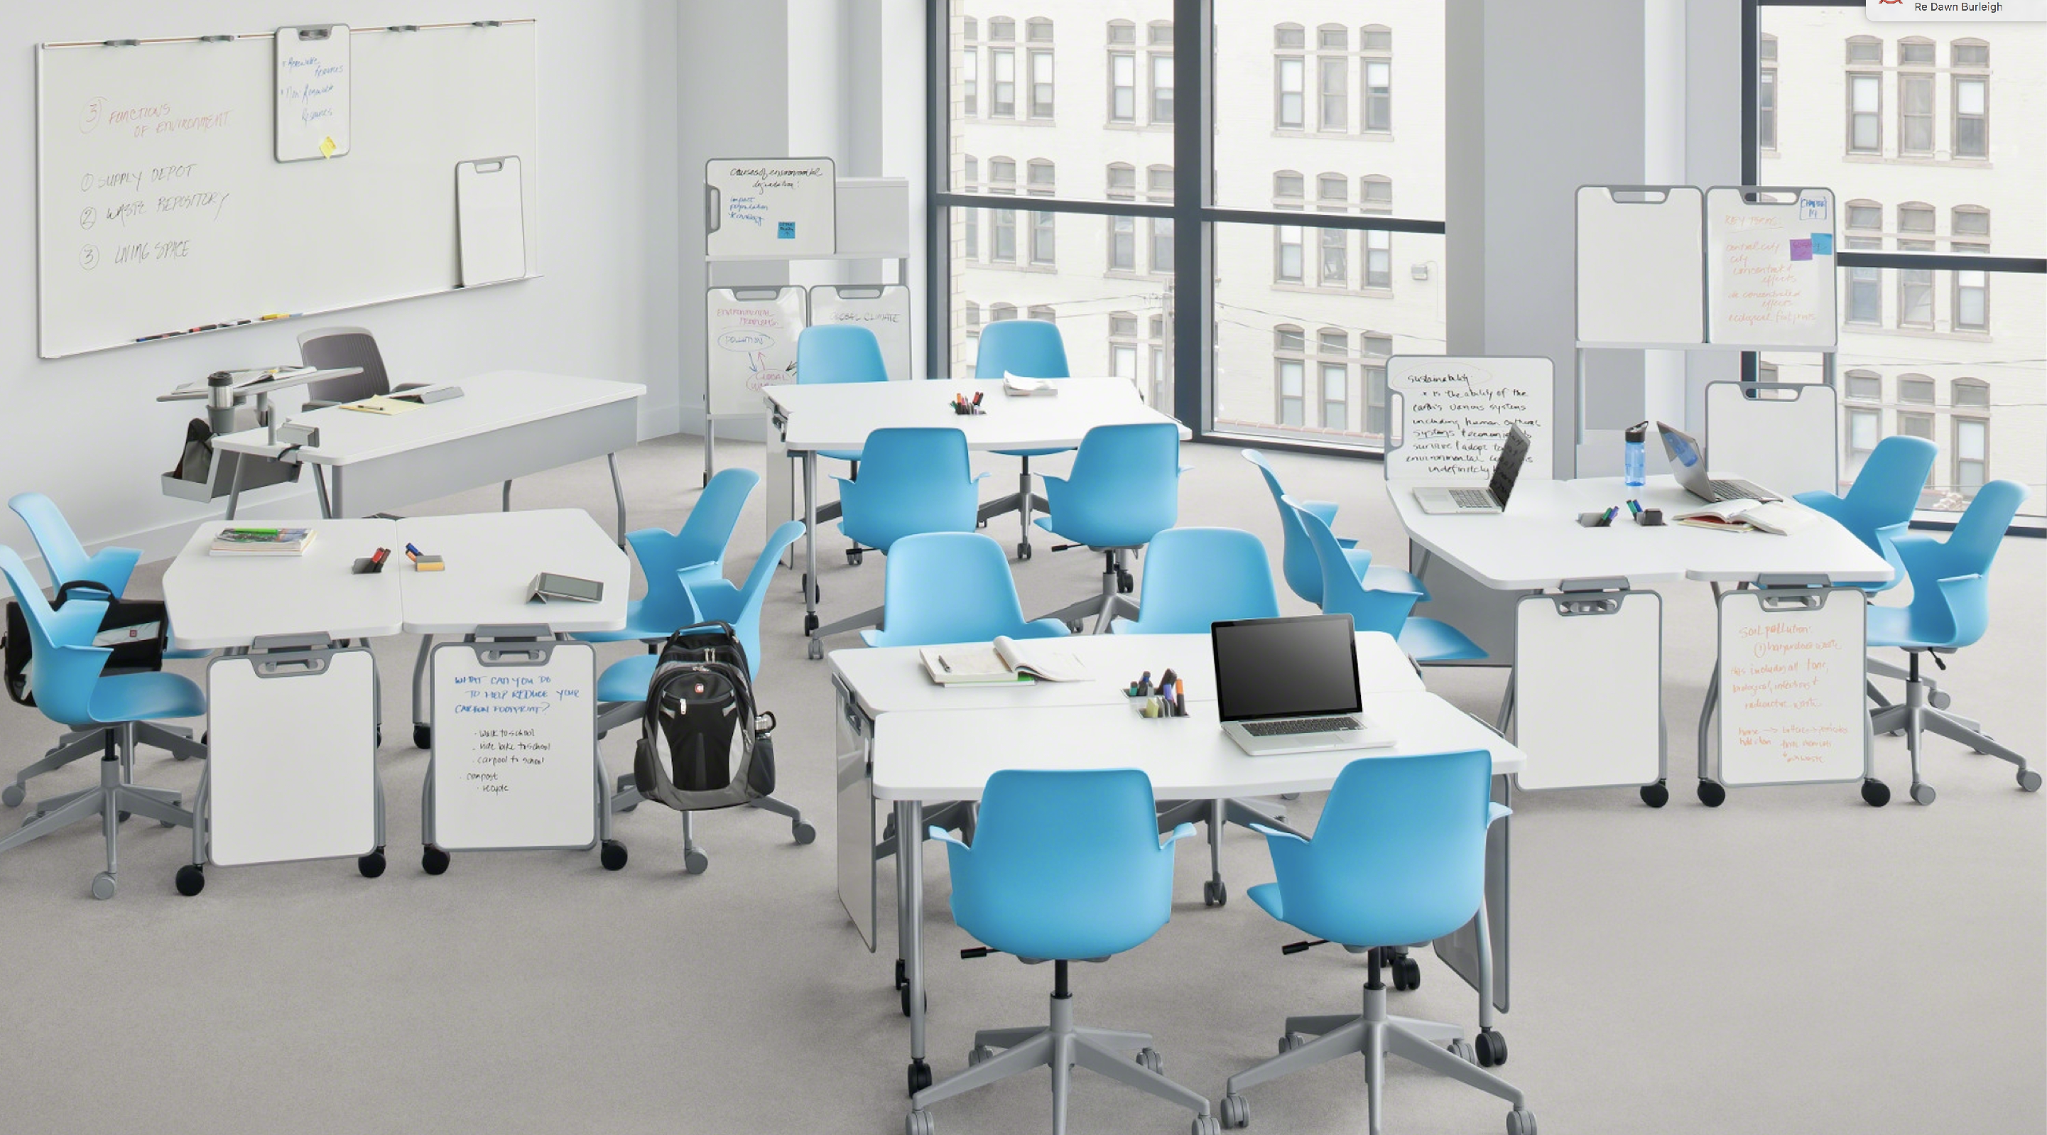
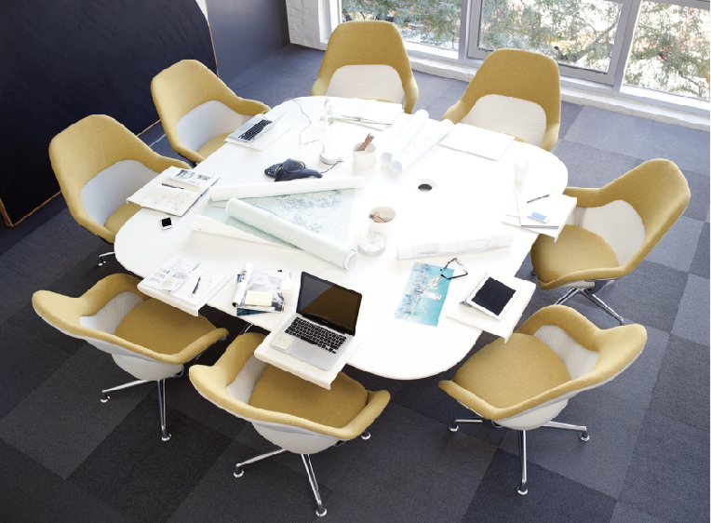
Notes:
The space would be flexible - furniture and technology would be moveable to the extent possible. Reconfigurable - think of how the ScaleUp room is rigid and fixed. This space would have some of the same features but flexible and customizable to meet the needs of the instructor or learners. A place where you send students to work in groups or individually.

Slide 3
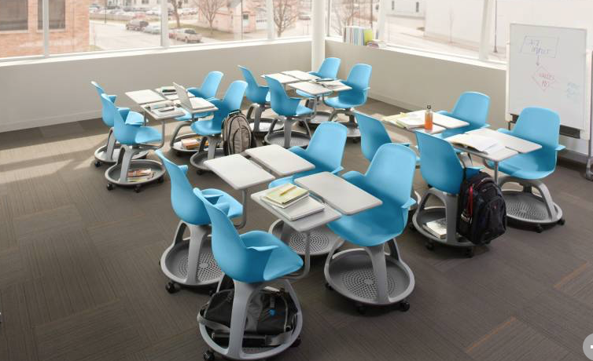
Notes:
A place where students collaborate, share, micro teaching spaces - small presentation areas, larger group meet-up space, pair or small group interaction spaces; where students can reconfigure the space to meet their needs. To the extent we can make it reconfigurable.

Slide 4
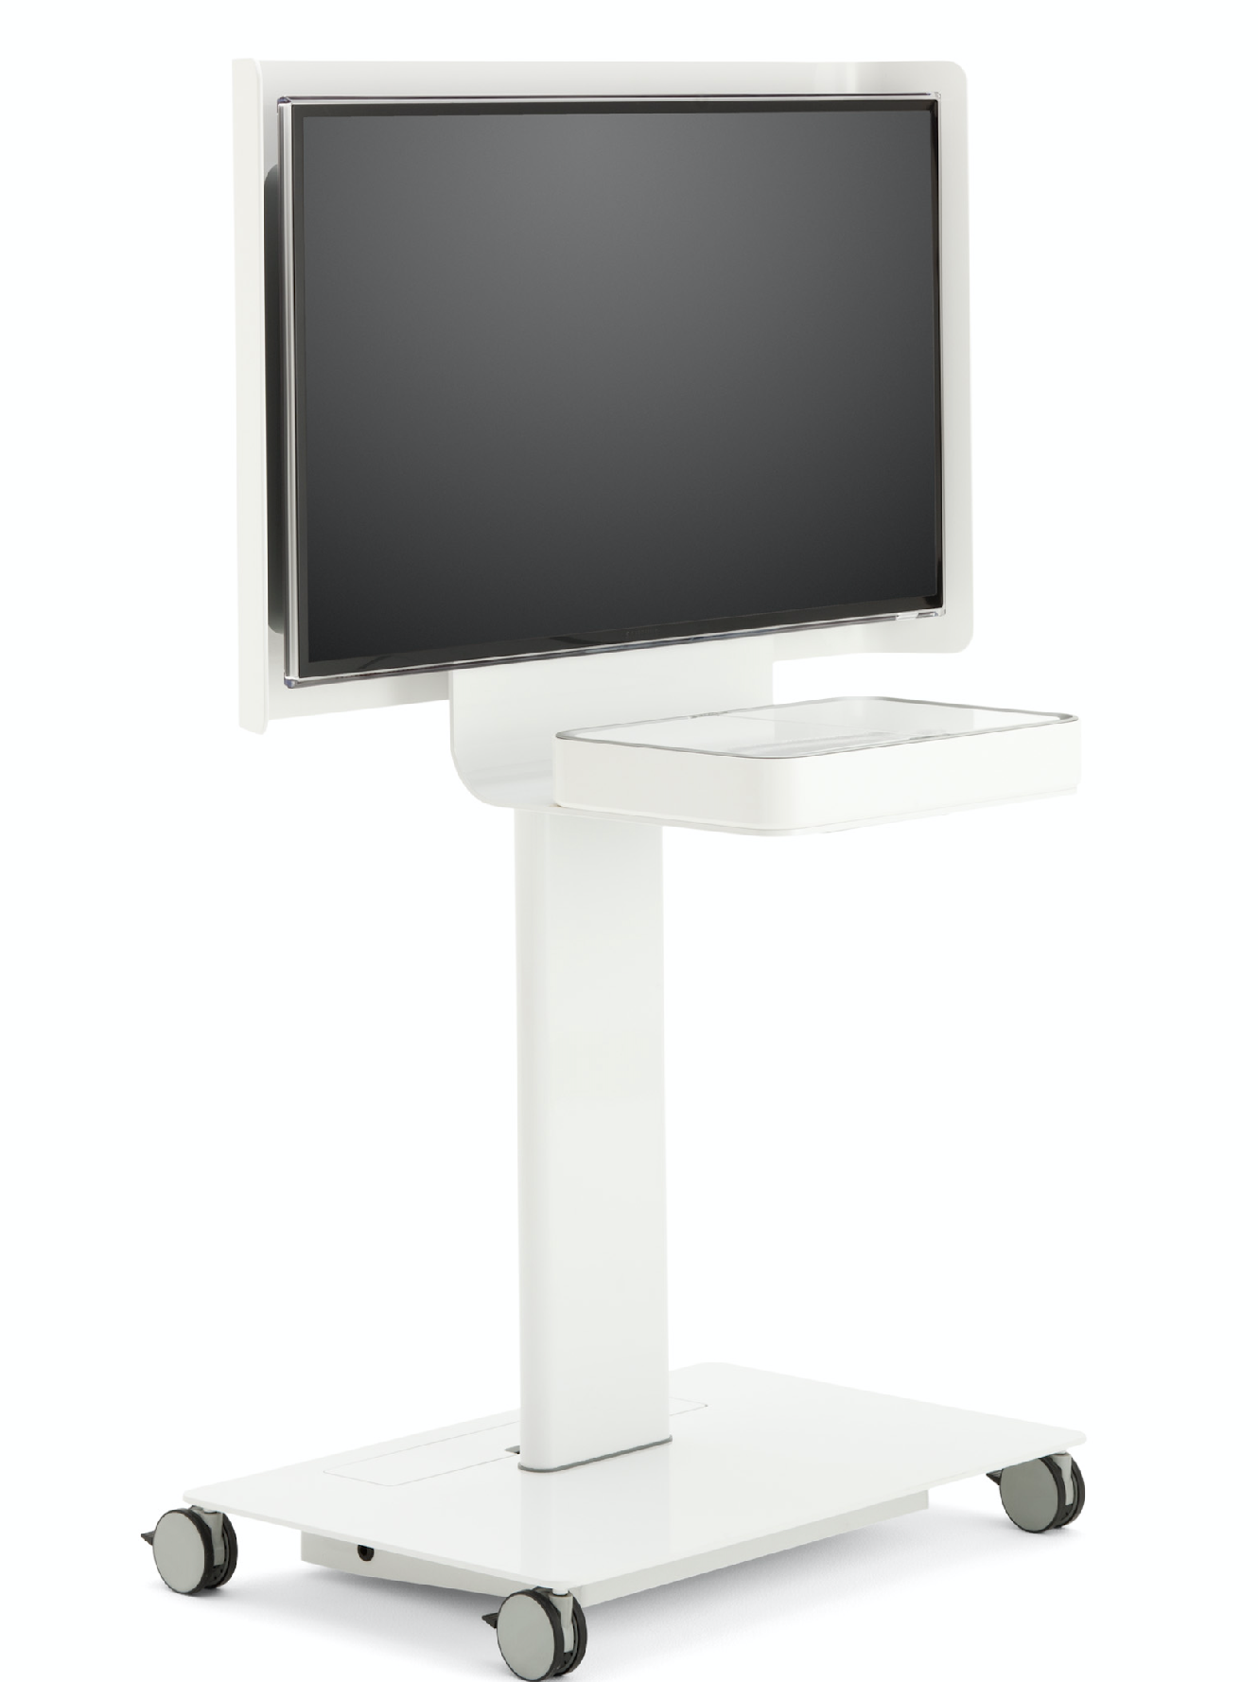
Notes:
Portable Media-scapes (a few ScaleUP like areas - or ways of creating that).

Slide 5
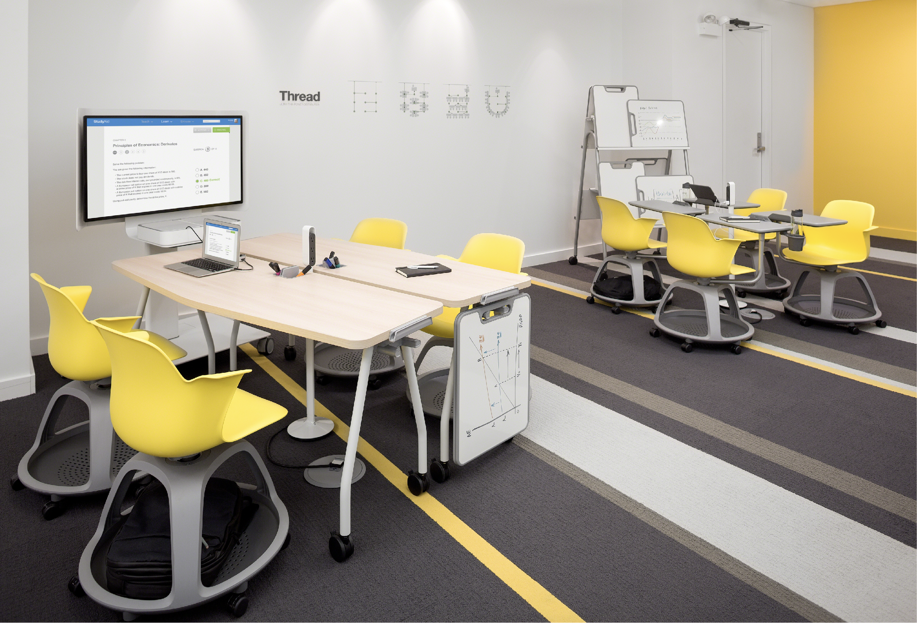

Slide 6
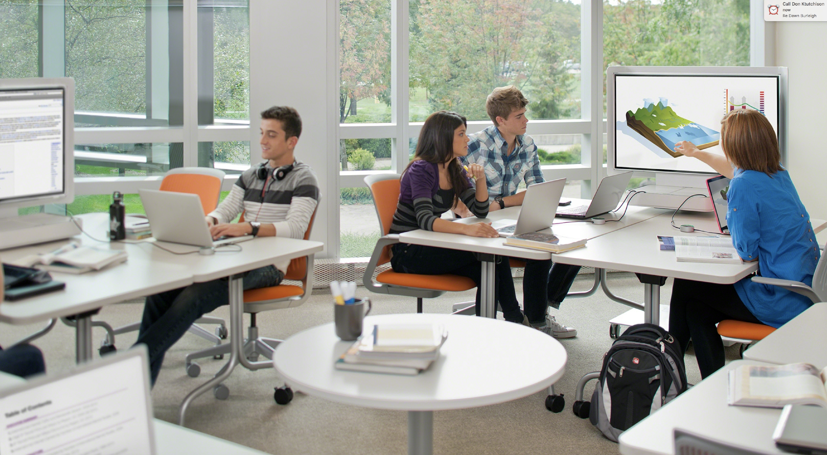

Slide 7
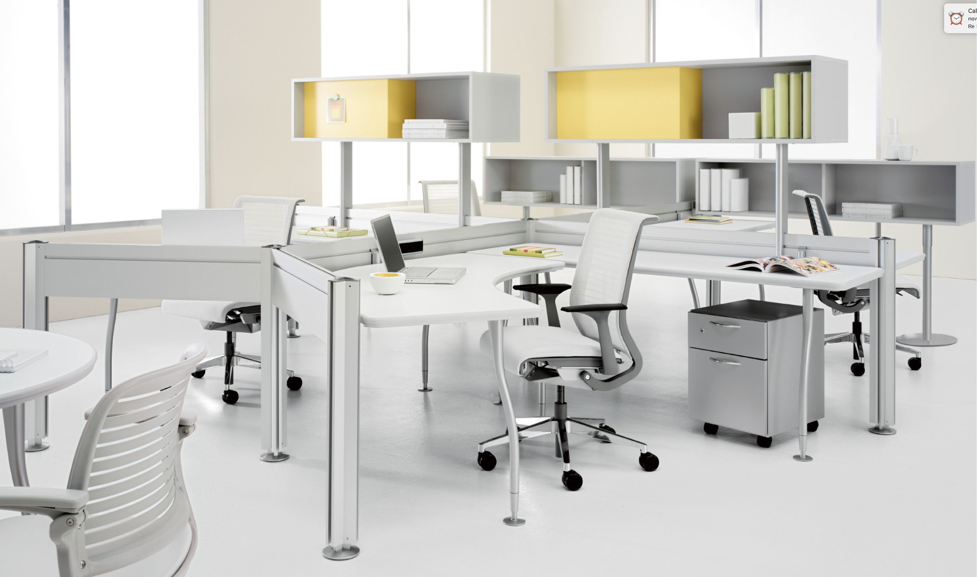
Notes:
Flexible moveable cubicles could be built for small group or individual work.

Slide 8
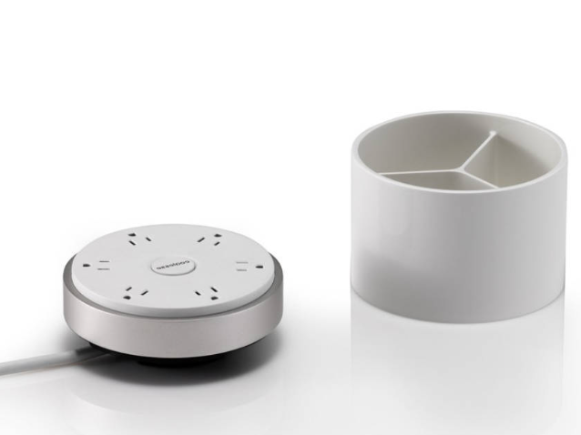
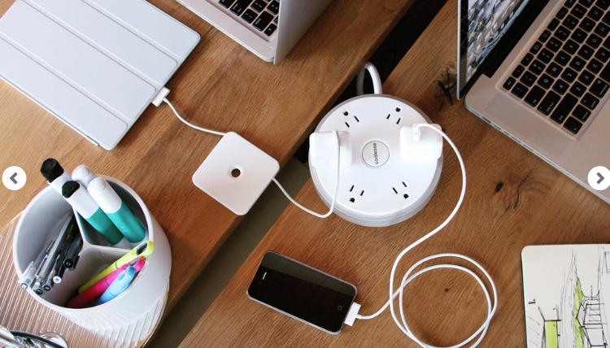
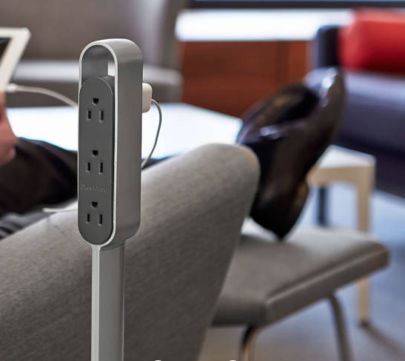
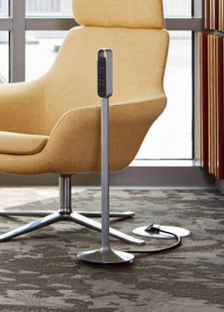
Notes:
The floor would be raised so that we had power going everywhere.

Slide 9
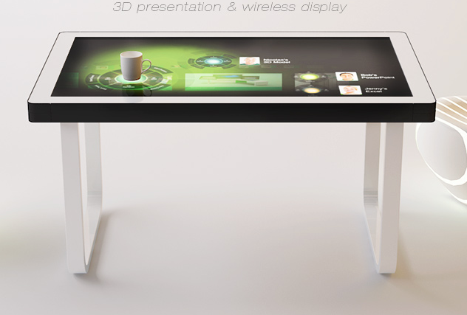
Touch Screen Tables
Notes:
Perhaps have a few of these to experiment with.

Slide 10
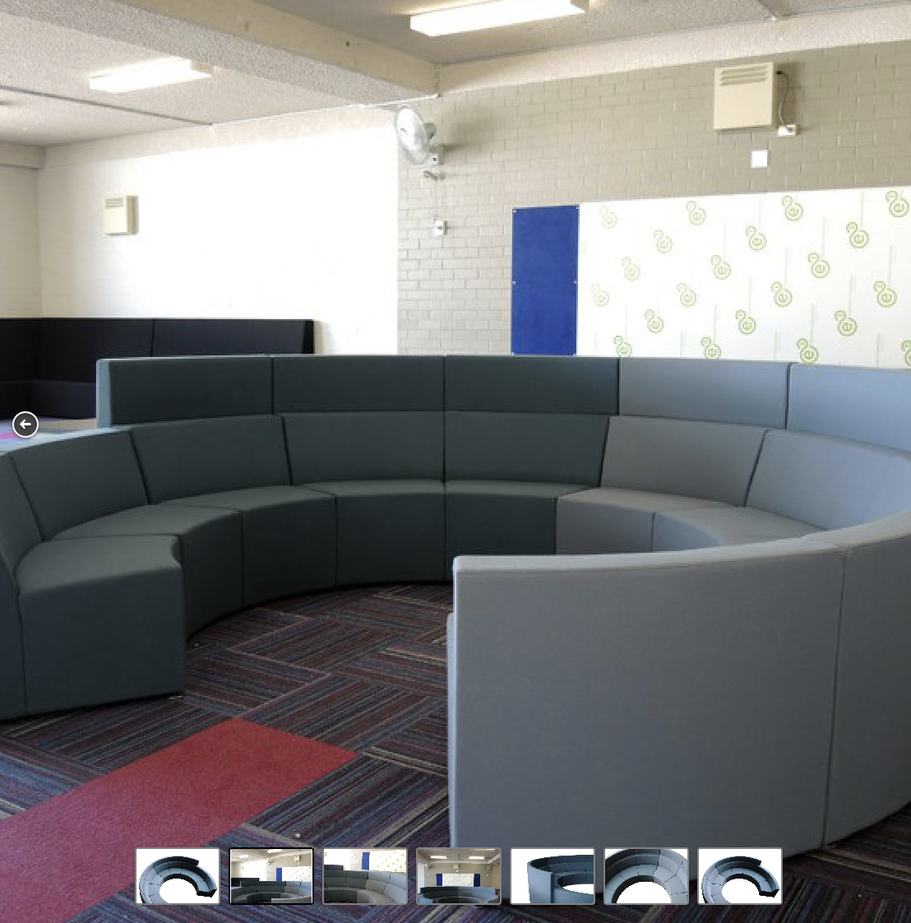
Notes:
Brainstorming corner with curved lounging furniture that could be reconfigurable.

Slide 11
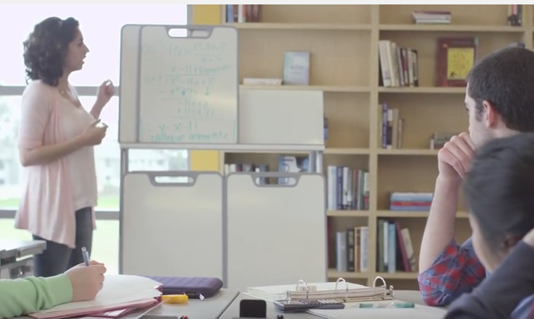

Slide 12
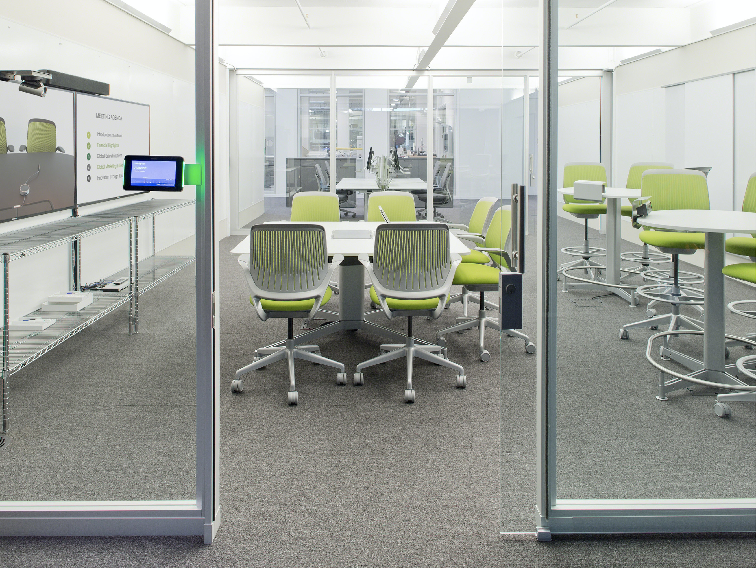
Notes:
A space that would be modern and inviting.
We could also have break out rooms - refurbish the Faculty offices.
The breakout rooms could be used for specialized things like 3D Printing, Video Editing, Robotics, Coding/Arduino/RaspberryPi, etc. In addition these rooms could be multi-purpose and used by the Counseling program.

